Slide 1
Laptop Shop using Spring Boot
Team Members Enrolment Number
Vivek Khobragade - EBEON0722629139
Vishal Lokhande - EBEON0722634455
Vamsi Doma - EBEON0722633124
Jerome David - EBEON0722114452
Mohammed Ali Pasha - EBEON0722632534
Guided by
Varadharajan A

Slide 2
Laptop Shop using Spring Boot
ADMIN MODULE
Home Page
Login Page
Registration Page
SSO (Single Sign-On)
Buyer Login
Admin Login
Admin Page
Add Products
Add Categories

Slide 3
Laptop Shop using Spring Boot
The primary goal of e-commerce is to reach maximum customers at the right time to increase sales and profitability of the business. Functions of e-commerce include buying and selling goods, transmitting funds or data over the internet.
Admin and Login Modules
Home Page – For Admin as well Customers,Login with authorization based on the user whether it is Admin or Customer, Added Single Sign-on (Login with google ) if Customer don’t want to enter email and password , Adding different Categories , adding products according to separate categories

Slide 4
Module 1 Admin Page
Definition
when user is login and enters the home page. Navigation bar contains of contact us, shop, my profile cart and logout option.
But User will not able to redirect to Admin page, because in order to open admin page user must enter password and email will only known to admin.
After entering login details admin will go to Admin Page where he get two options
First “Add Categories”
Second “Add Products”

Slide 5
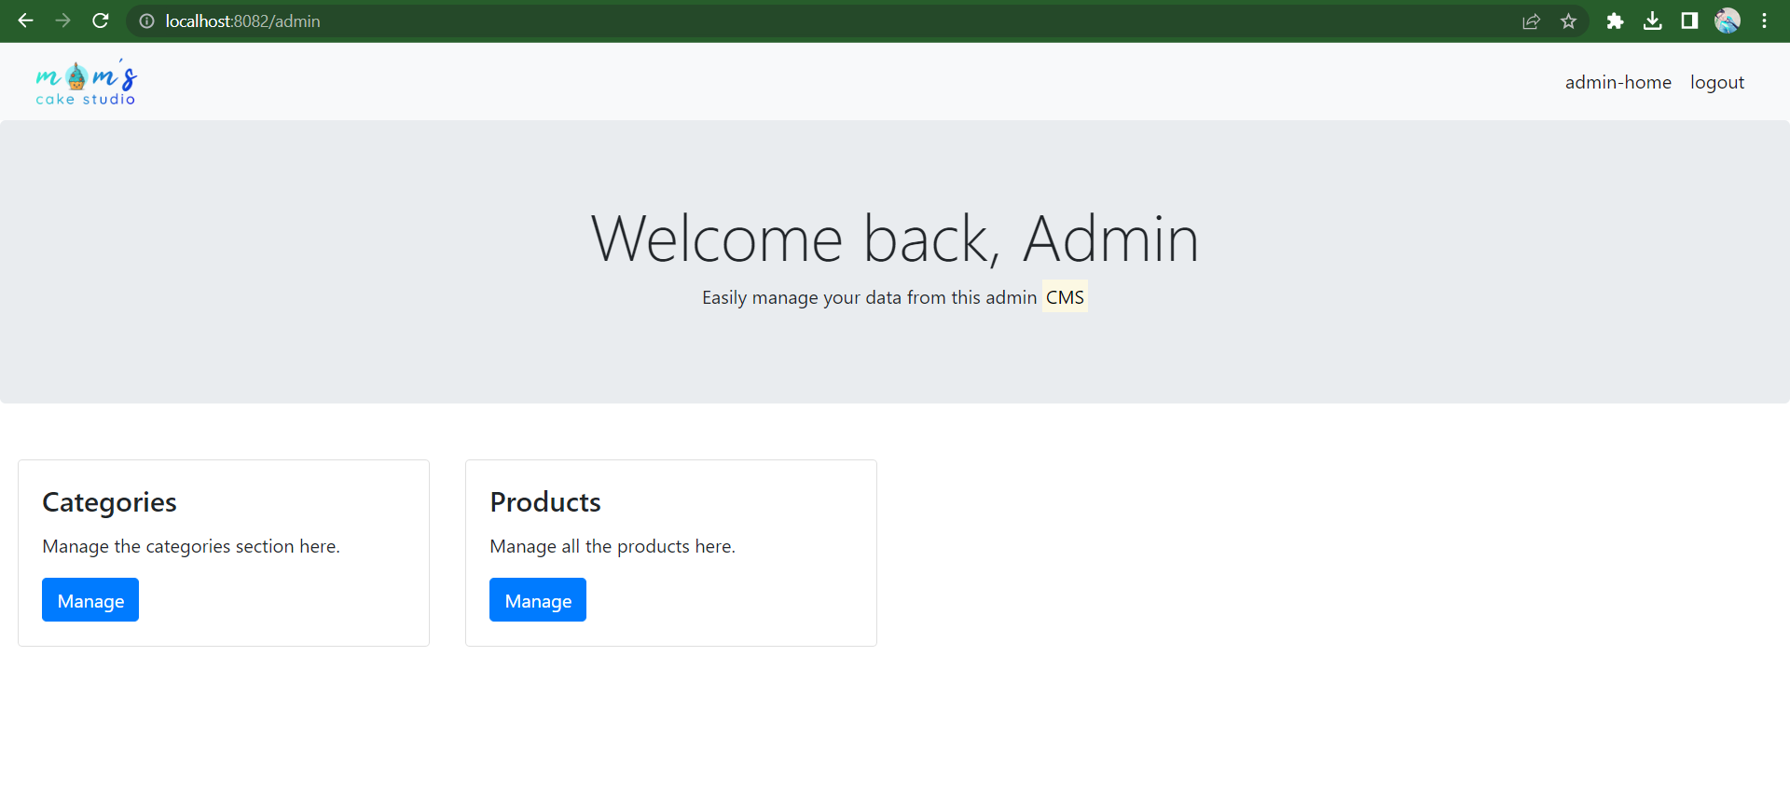

Slide 6
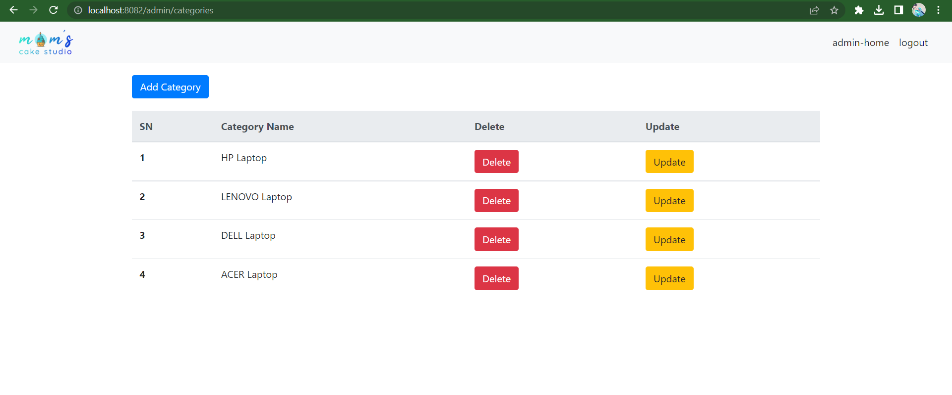

Slide 7
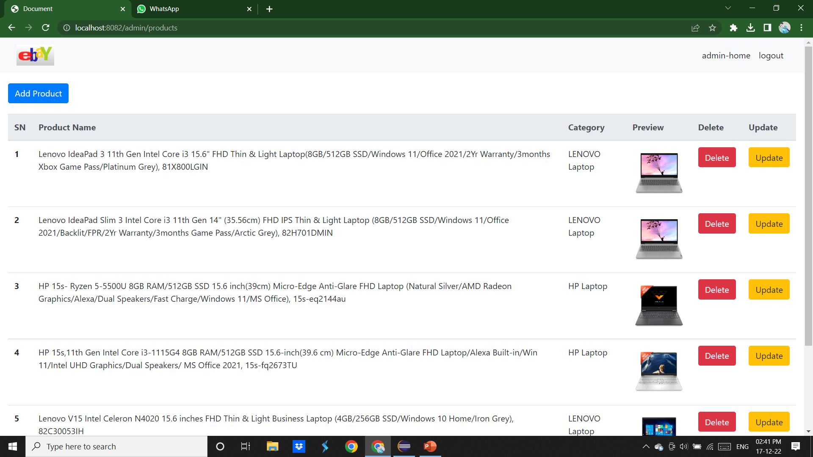

Slide 8
Module 2 Login Page
Definition
User will enter the login details,which consists of email and password
Login Page warns user, if user tries to enter the invalid details.
If user is new then they can register, after registration of the user will jump to login page.
Below login button, there is button called as “Sign in with Google”
User will enter home page without entering login details.

Slide 9
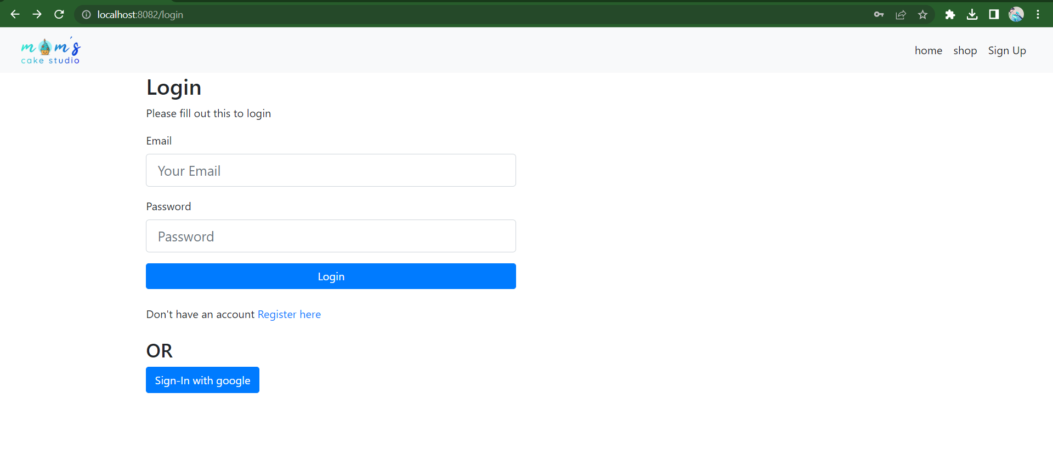

Slide 10
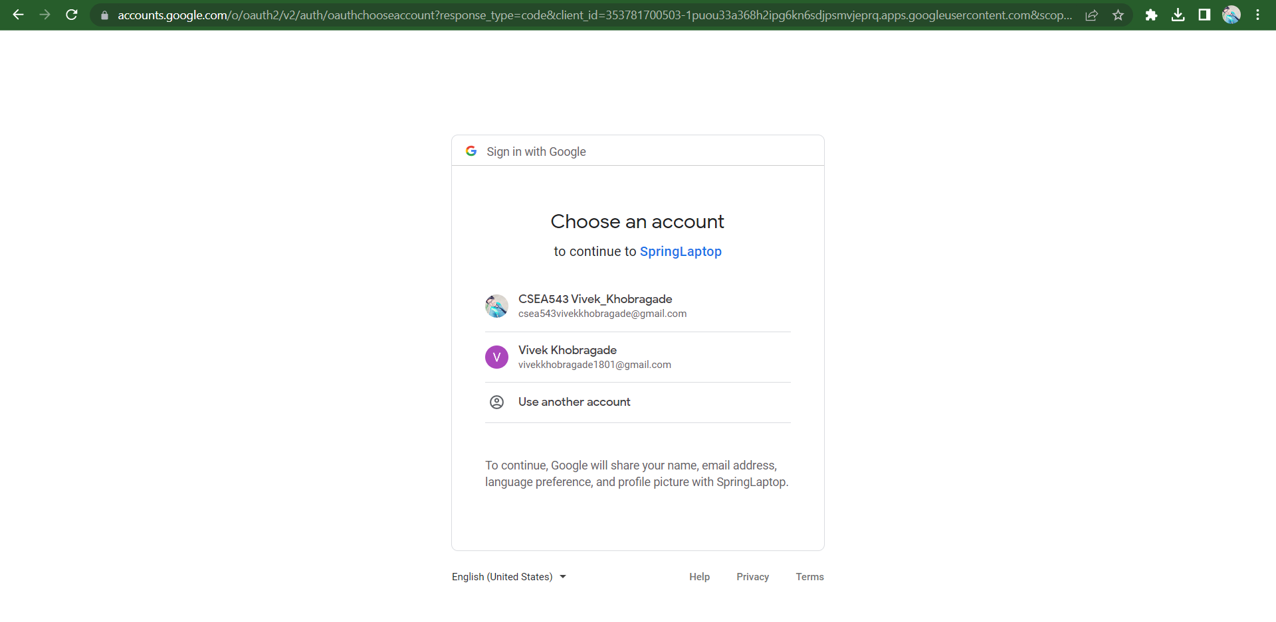

Slide 11
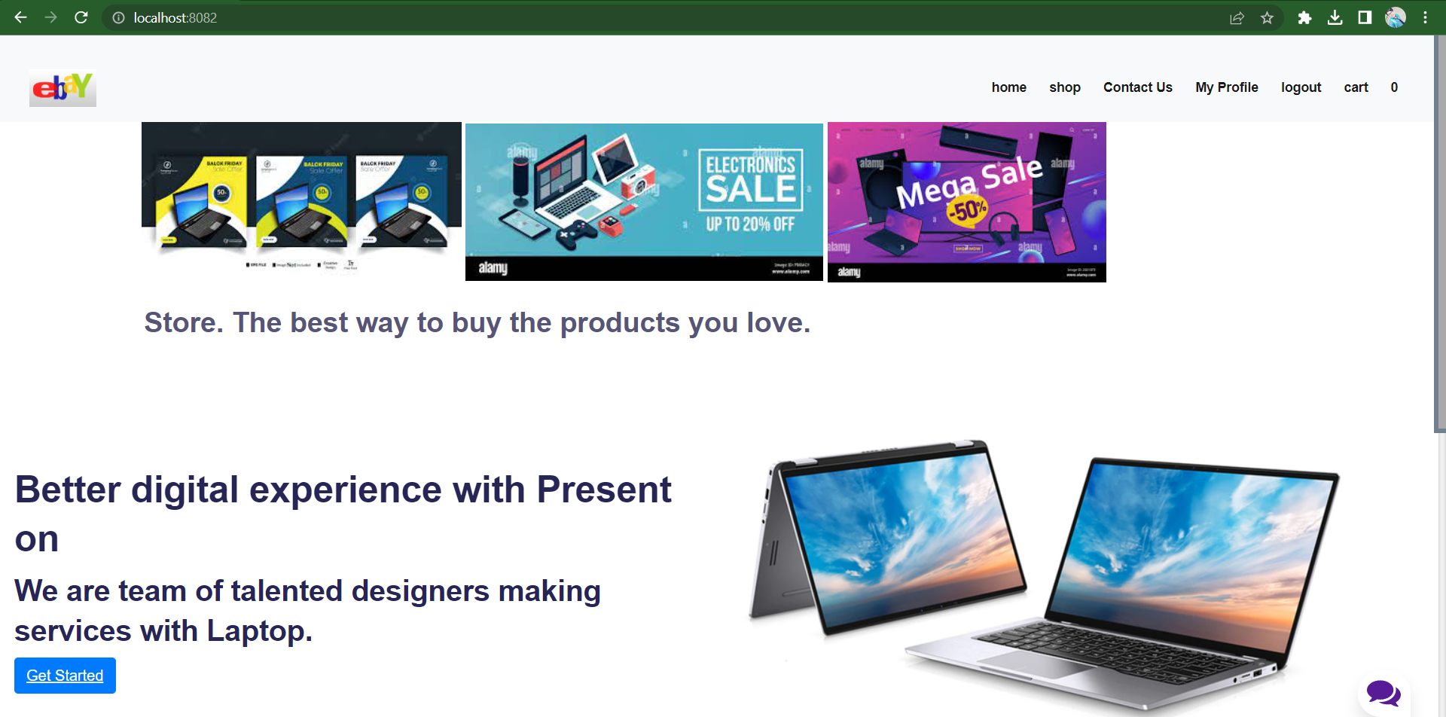

Slide 12
Module 3 Registration
User will enter details in form with contains text boxes to fill
First name
Last name
Email address
Password
And button named “Register”
And at last there will be text “Sign”, if user is existing.
After filling details it’ll automatically stored in database.

Slide 13
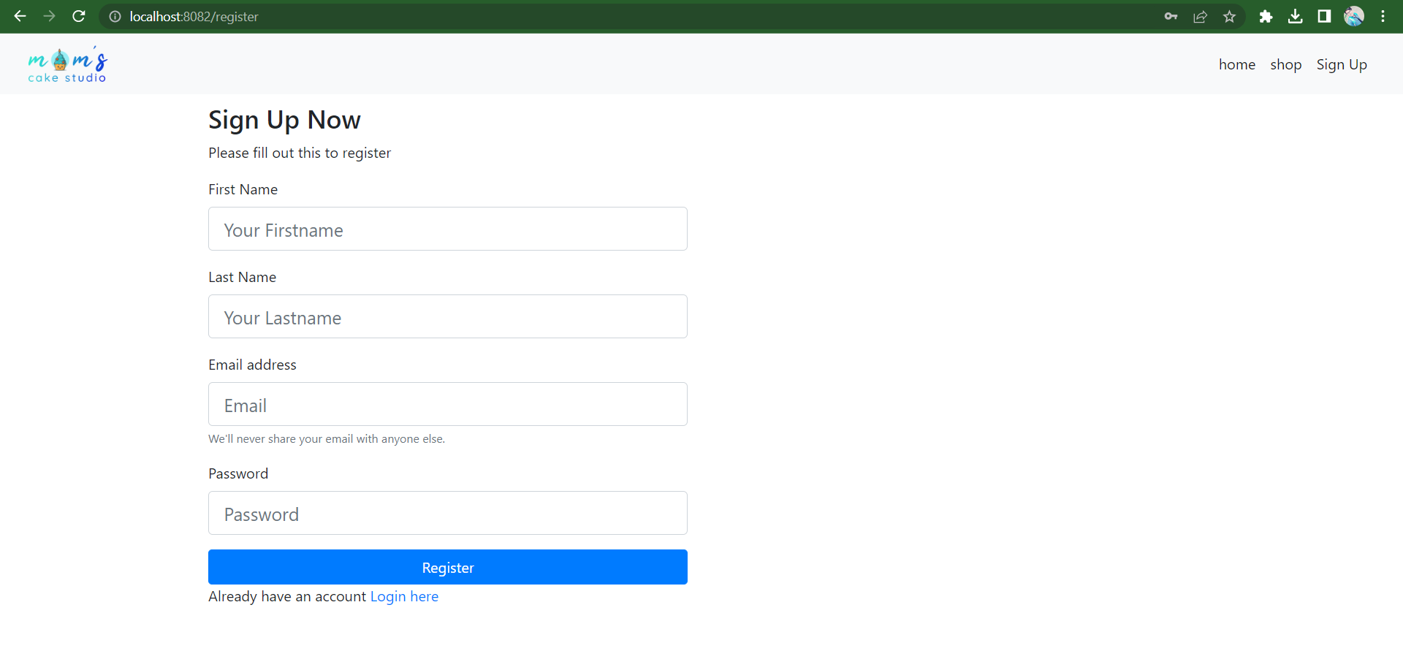

Slide 14
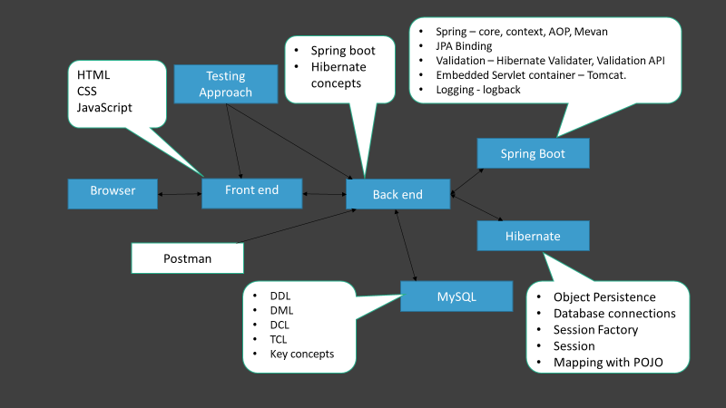
Project overview
Project Architecture
Approved
Customer
Pending
Login
Dashboard
Stock maintenance
Report
Order
checkout

Slide 15
Spring – core, context, AOP, Mevan
JPA Binding
Validation – Hibernate Validater, Validation API
Embedded Servlet container – Tomcat.
Logging - logback
Spring boot
Hibernate concepts
HTML
CSS
JavaScript
Testing Approach
Spring Boot
Browser
Front end
Back end
Hibernate
Postman
DDL
DML
DCL
TCL
Key concepts
MySQL
Object Persistence
Database connections
Session Factory
Session
Mapping with POJO

Slide 16


Dataflow diagram
Admin
Add product to cart
Change/Update categories
Shopping Cart
Add product to cart
Cart Items
Browse
customer
Quantity
View/edit cart
Item Details
Checkout
Item Details

Slide 17
Challenging issues
Most of the time during implementation of SSO (Single Sign-on), we face issues when we expect that application will show list of email ids, but it fails to do that.
In order to solve this problem, developer must check in “application.properties” and must avoid “ ”, in between client-id, secret key.
But if he fails to execute again then he need to refresh the project so that he gets new secret key in console.cloud.google.com.
And after entering secret key user will able to see output.

Slide 18
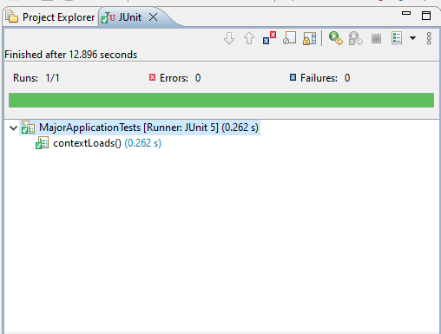
Testing

Slide 19
Features about the module
SSO (Single Sign-on)
OAuth(Open Authorization) is a standard protocol for delegated authorization. Simply put, OAuth is an authorization protocol that allows you to approve one application interacting with another, on your behalf without giving away your credentials.
Role-based Authentication
Authentication is used to determine the identity of the user and verify and validate that identity. Authorization checks the permissions of the authenticated user and controls access to functions based on the roles that are assigned to the user.

Slide 20
Future enhancement
The scope of shopping websites in India bloomed during the pandemic. This success can also be the result of increased internet use among our generation.
You can deploy Spring Boot applications to a variety of cloud platforms like heruko,kubernetics,AWS (Amazon web services).

Slide 21
Quality improvement task
Mention the approached Testing concepts : Junit in Spring boot
DevOps tools approach : Mevan,Github.

Slide 22
Conclusion
This project helped us in gaining valuable information and practical knowledge on several topics like designing web pages and management of database.
This project has given us great satisfaction in having designed an application which can be implemented to any nearby shops or branded shops selling various kinds of products by simple modifications.

